Slide 1
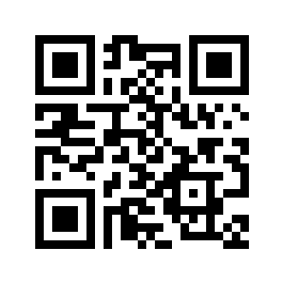
Digital Accessibility
Carolyn Speer, Ph.D., CPACC
Manager, Instructional Design and Access
October 22, 2019

Slide 2
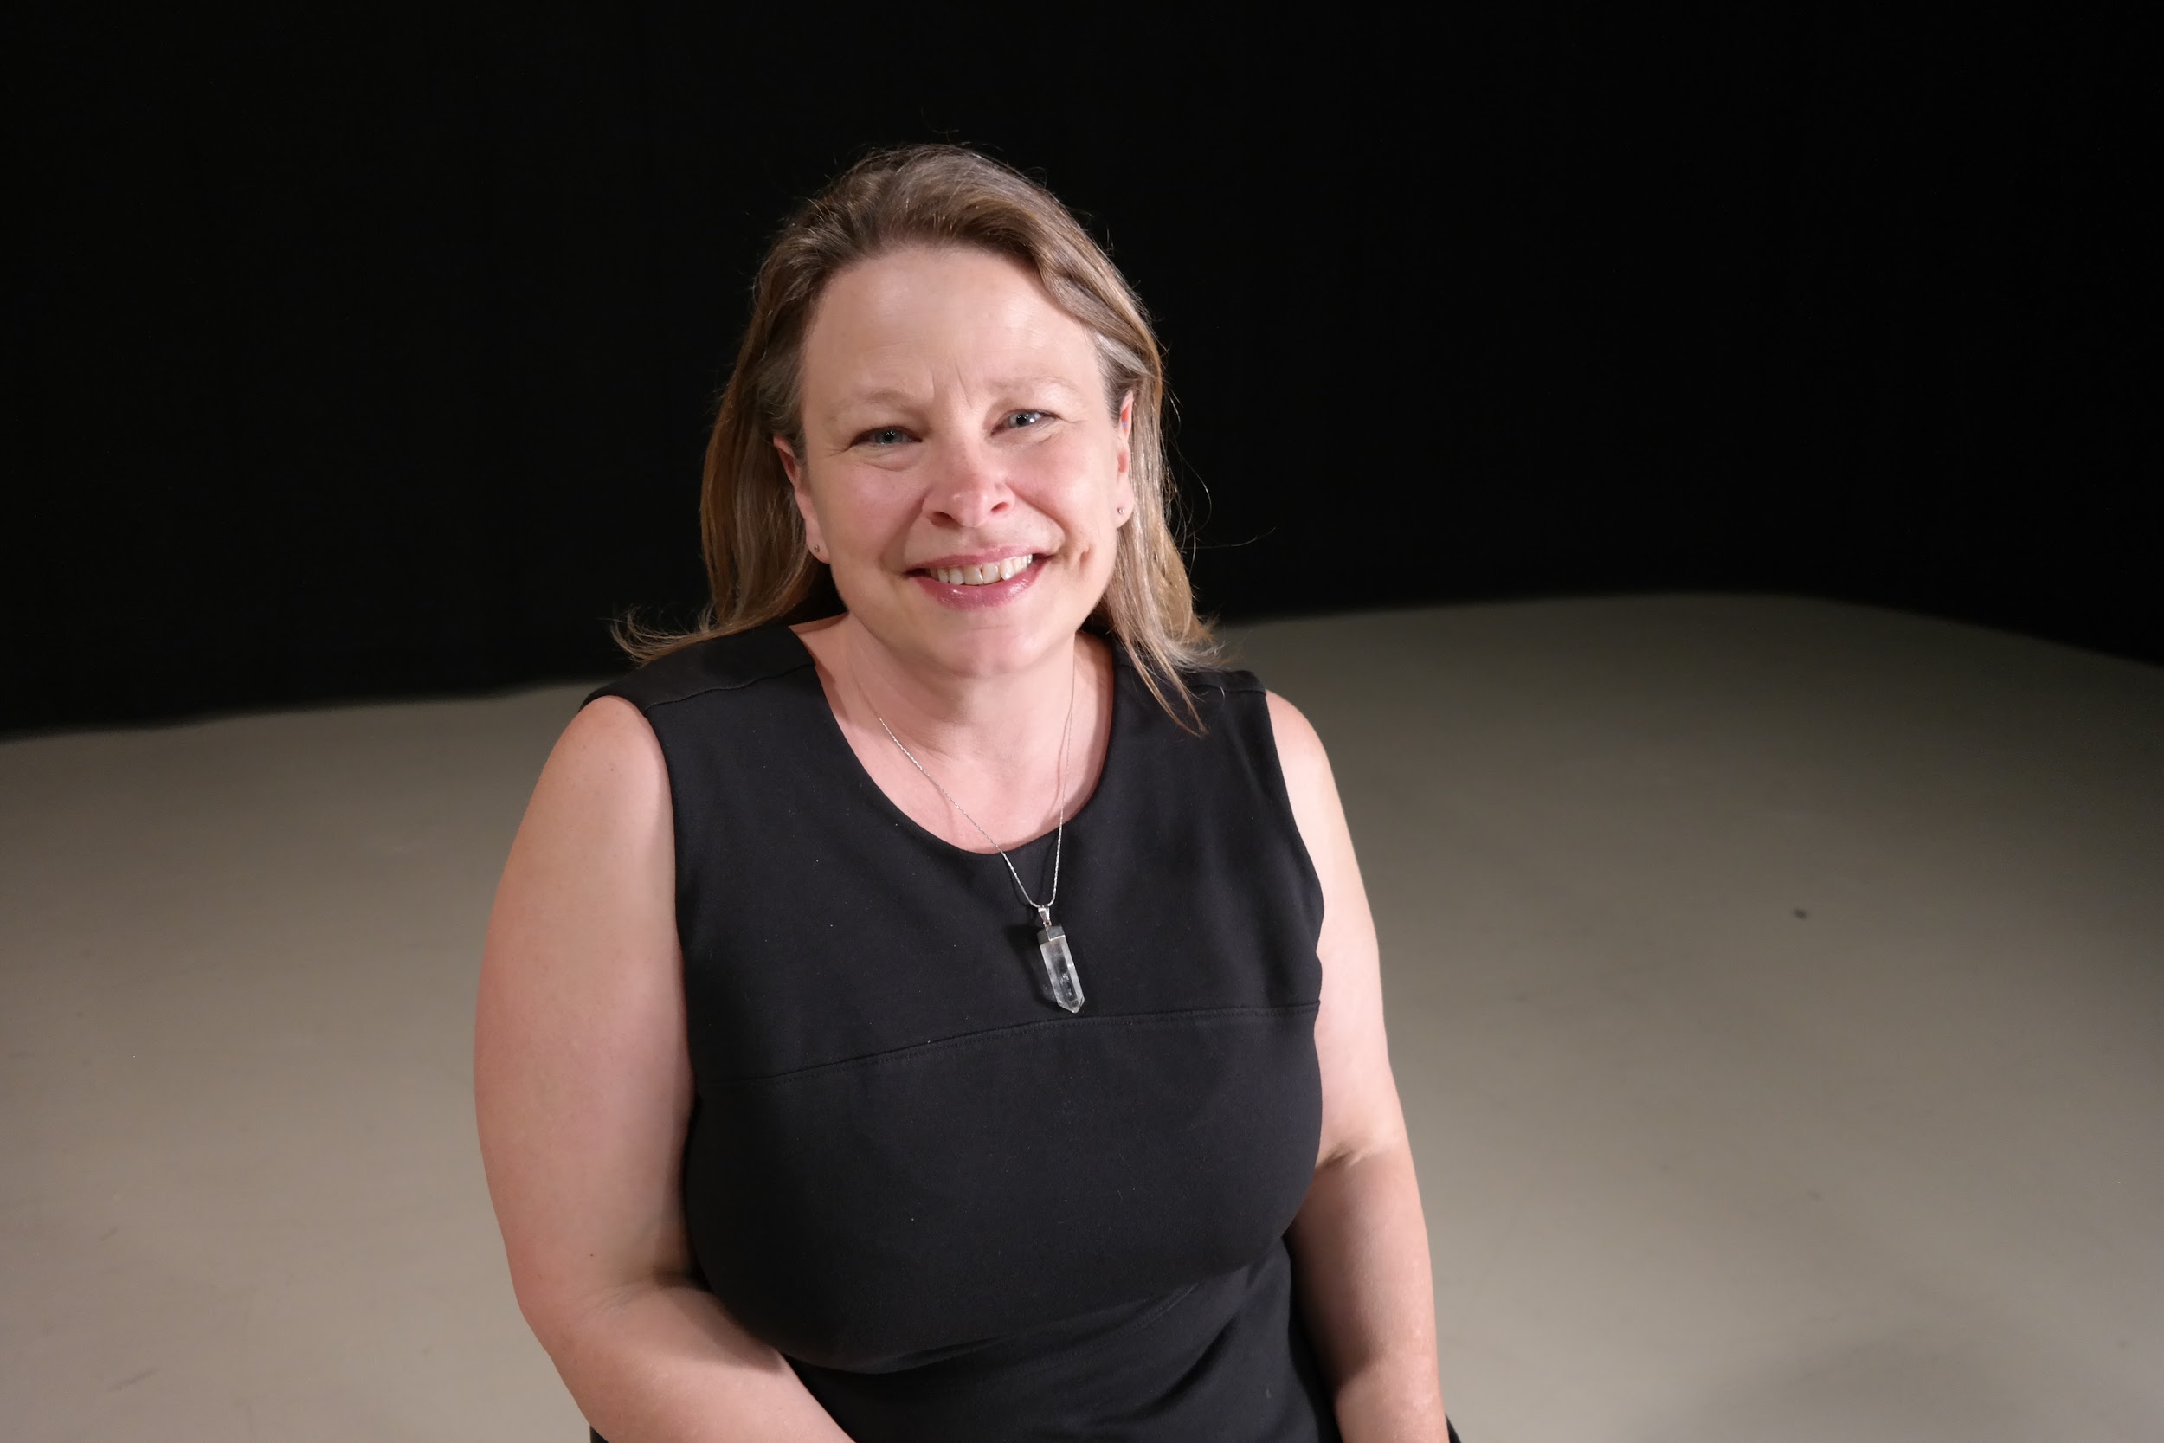
Carolyn Speer, Ph.D., CPACC
Over 25 years in higher education, 20 years in online education
Manager of Instructional Design and Access at Wichita State University
Co-Founder of the Kansas Accessibility Resources Network (KSARN)
Certified Professional in Accessibility Core Competencies by the International Association of Accessibility Professionals
National speaker and consultant on accessibility issues in higher education

Slide 3
Today's Agenda
Understand the "what and why" of accessibility
What is a digital document?
Accessible digital documents
Accessible email
Accessible webpages
Review

Slide 4
What and Why Accessibility?

Slide 5
What is Accessibility and Why is it Important?
Accessibility = access. The better your accessibility, the more people can access your information
Accessibility is important because
It is the right way to behave
It’s the law (Domino’s v Robles settles it)
Accessibility is not the same thing as ”accommodation”
Accommodation is the tailoring of an event or process to an individual
Curb cuts and ”handicap parking” are accessibility measures
Carrying a person in a wheelchair down steps in an emergency is an accommodation

Slide 6
Digital Document Accessibility

Slide 7
What Are Digital Documents?
Anything you create in Word, even for paper distribution (See examples of accessible paper documents)
Anything saved in a file such as: .doc, .docx, .htm, .PDF
Email
Anything on the Web

Slide 8
How a Computer Understands a Document
To a computer, a document is just information organized using different commands called “tags”
Tags are the computer’s way of knowing what kind of document element it is dealing with
When you create a document without tags, you circumvent a screen reader’s ability to maneuver through the document
You do not need to know how to code to create accessible documents
You do have to develop new habits. Now.

Slide 9
Creation of Accessible Digital Documents
Use your Microsoft products and the tools they contain
Do not assume that if you manipulate something visually that you have created an accessible document
For example, you should create headings in your document using the Styles feature in Word, not by changing the size and font directly

Slide 10
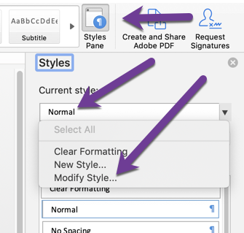
Using Styles
Styles are highly customizable
To change a style, turn on the Styles Pane and choose the font to change and then choose “modify style”.
You only need to do that once per document, per style.

Slide 11
Change the Style to Look How You Want

Slide 12
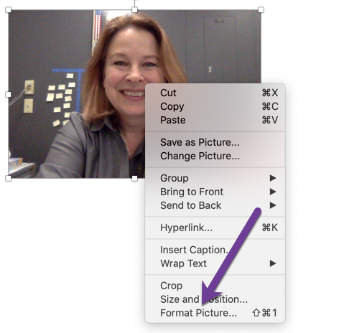
When you Embed a Picture (Graph, Figure, etc.)
Add your file to the document and then “right click”, and choose “format picture”

Slide 13
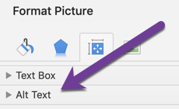
More on Adding an Alt Tag
Choose the “size and properties” area:
And expand “alt text” line:

Slide 14
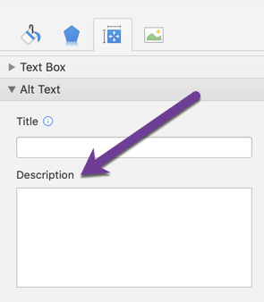
Alt Text … Still Going!
Add a ”description”. “Title” is optional and may not always be a choice:

Slide 15
What Makes a Good Alt Tag?
Keep it short
But be descriptive to your purpose
Be aware, “real people” are going to hear your alt tag!
How would you tag this dog and cat photo?
Photo Credit: Photo by Anusha Barwa on Unsplash

Slide 16
More on Creation of Digital Documents
Lean toward “sans serif” choices: Arial is good if you can’t remember
Embedded links: raw for print, named for digital
Raw: https://ksarn.org
Named: KSARN
Save as a .PDF or .HTM if the document will go online unless there is a reason you want someone to be able to change your document

Slide 17
Digital Document Miscellaneous
Avoid unnecessary bells and whistles (and color)
Avoid unnecessary tables
Avoid unnecessary visual and organizational complexity
Name your hyperlinks something descriptive, not “click here”
Avoid handwritten documents

Slide 18
Use the Accessibility Checker, and Believe It!
Microsoft’s accessibility checker is easy to use
Change all “errors”
Take ”warnings” seriously
Find the checker under the “review” tab
If you don’t see an accessibility checker, you need to update your software

Slide 19
Remediation of Existing Inaccessible Documents
Remediation is hard. Try to find an accessible alternative first!
Consider re-creating (retyping is almost always easier!)
First step toward remediating a document: use your accessibility checker!

Slide 20
Common things to remediate
Things to check:
Can you highlight text?
If no, a screen reader can’t read it.
If no, Acrobat Pro (DC) has an optical character recognition process. Save first!
Are there Alt tags and other tagging?
Is reading order okay?
Is there an over-reliance on tables?
Is there unnecessary clutter (pictures, color, etc.)?

Slide 21
What You Need to Succeed: Digital Documents
Kansas Accessibility Resources Network Courses
Accessible Digital Documents
Notes:
https://ksarn.org/courses/creating-accessible-digital-documents/

Slide 22
Accessible Emails

Slide 23
Key to Accessible Emails: Remember They are Documents
Treat emails like documents
Avoid changing background and font color
Mitigate for images that contain information
Give links meaningful text links (no raw URLs)

Slide 24
Example of Image Mitigation
Information is given in the image
Information is also written separately from the image (both for the headline and for the content item)

Slide 25
Web Accessibility

Slide 26
Web Accessibility Standards
Website accessibility should meet WCAG 2.0 AA standards
This means your website can be accessed and used by someone using a screen reader
Things to watch out for:
Uploaded PDF documents that are not accessible
Photographs that do not have a text alternative (“Alt Tag”)
Keyboard “traps”
What you need to succeed:
Training (KSARN has a course)
Web software that checks for problems

Slide 27
Take a Tour of an Inaccessible Webpage
The University of Washington has created a series of training sites, and they might be helpful to you or your web staff:
Inaccessible Webpage
Access Issues Discussed
Accessible Version of Webpage
Notes:
Inaccessible webpage: http://www.washington.edu/accesscomputing/AU/before.html#
Accessible version of webpage: http://www.washington.edu/accesscomputing/AU/after.html
Access Issues Discussed: http://www.washington.edu/accesscomputing/AU/issues.html

Slide 28
What You Need to Succeed: Web
Kansas Accessibility Resources Network Courses
Introduction to Web Accessibility
Notes:
https://ksarn.org/courses/web-accessibility/

Slide 29
Audio and Video

Slide 30
Working with Audio and Video
Audio files need a transcript
Audio/video files need captioning and might need description
Pure video (no audio) requires audio description
Captioning can be done with YouTube, or Google’s “Voice Typing” tool (must access using Chrome), but these captions must be edited.
Captioning services like Rev.com can be a good option: $1 a minute. Ask for the output in all available formats (doesn’t cost extra)
Social media counts! The responsibility for accessibility is yours.

Slide 31
What You Need to Succeed: Video
Kansas Accessibility Resources Network Courses
Creating Accessible Video
Notes:
https://ksarn.org/courses/creating-accessible-video/

Slide 32
Digital Document Review

Slide 33
Review
Remediation is hard. It’s easier to retype
Use Microsoft products to produce new content when possible
Use your Microsoft tools when creating content (styles sheets, bullet/numbers, checker)
Use Arial (just kidding…but sans serif is best)
Remember: HTM files work best for online use, but PDF will work if it passes all accessibility checks
Remember: You have to write the Alt Tags
Remember: Accessibility is not optional or up for debate

Slide 34
What You Need to Succeed: Other Accessibility Issues
Kansas Accessibility Resources Network Courses
Accessible Digital Documents
Notes:
https://ksarn.org/courses/creating-accessible-digital-documents/

Slide 35
Thank you!
Questions?
Notes:
https://ksarn.org/faq/

