Slide 1
Comprehensive Accessibility Training Means Training Everyone … Including Students
Carolyn Speer Ph.D., CPACC
Notes:
Welcome to the presentation “Comprehensive accessibility training means training everyone, including students” by Dr. Carolyn Speer.

Slide 2
KSARN.org/AHEAD2019/
Notes:
This presentation has a companion webpage. You can find these slides along with a scripted voiceover at www.ksarn.org/ahead2019/ or, if you prefer you can use the qr code provided on this slide.

Slide 3
Conference Inclusion Statement
We ask you to join us in creating a culture that reflects…
Access and Inclusion
and
Civility and Respect
…this week and in all aspects of our organization.
Notes:
This is a presentation for the AHEAD equity and excellence conference. AHEAD asks you join us in creating a culture that reflects access and inclusion and civility and respect, this week and in all aspects of our organization.

Slide 4
Working together we will:
Seek to define accessibility
Explore accessibility’s goals
Consider the instructor’s role in accessibility
Ask ourselves … Who is the instructor?
Consider the challenge of accessibility training for students
Address questions (KSARN.org/FAQ/)
Before we start: who are you?
Notes:
In today’s presentation we will discuss:
Wichita state and your presenter, Carolyn Speer
Seek to define accessibility
Explore accessibility’s goals
Consider the instructor’s role in accessibility
Ask ourselves … Who is the instructor?
Consider the challenge of accessibility training for students
Address questions (KSARN.org/FAQ/)
Because remote attendees will not be participating synchronously and can’t ask questions, we suggest you refer to the Kansas Accessibility Resource Network’s Frequently Asked Questions index at https://ksarn.org/faq/

Slide 5
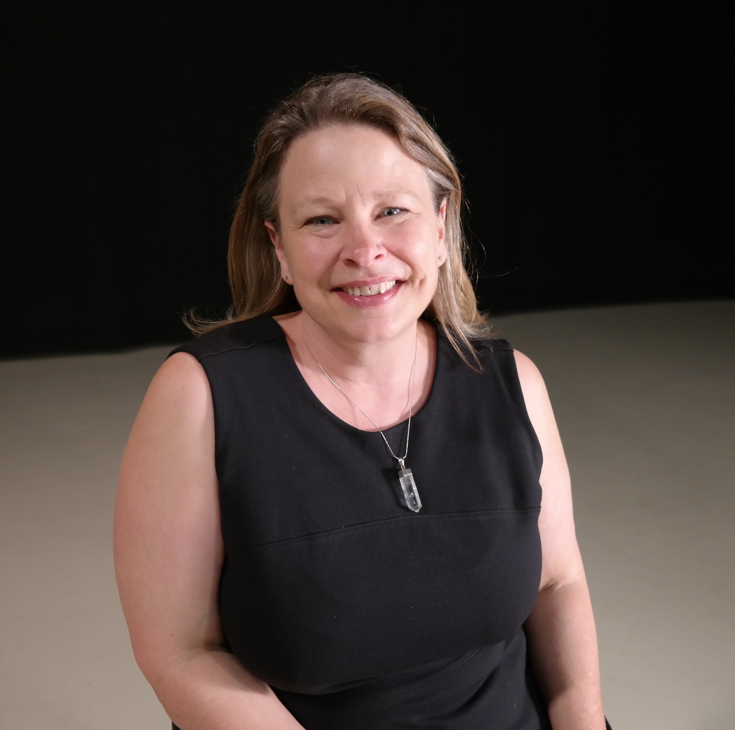
Carolyn Speer
Manager of Instructional Design and Access
Runs a team of 9 designers, ed-techs, and students
Training for all 1,100+ instructional staff
Earlier life as an assistant professor of English and Political Science
Notes:
Dr. Carolyn Speer, pictured on this slide, is the Manager of Instructional Design and Access at Wichita State. She runs a team of 9 full-time and 2 part-time staff including designers, ed techs, an EIT auditor and others. Earlier in her career, Dr. Speer was an English and Political Science professor at Friends University in Wichita, Kansas.

Slide 6
Wichita State University
Public 4-year university with 15,700 students (online and on-ground)
Doctoral Higher Research
40+ Masters degrees; 12 Doctoral degrees
Active “all content” agreement with the NFB (Deadline: Accessible by July, 2020)
Notes:
Wichita State University is a public 4-year university with approximately 15,700 students. WSU is a R2, “doctoral higher research” university with over 40 masters degrees and 12 doctoral degrees. WSU currently has an active all content agreement with the National Federation of the Blind with a deadline of full accessibility in July 2020. This slide contains a photograph of students entering the Rhatigan Student Center.

Slide 7
Question: What is accessibility? What are its goals?
Notes:
Question to consider: What is accessibility? What are its goals?

Slide 8
Accessibility is:
Advance actions that make information available to the largest number of people
without further intervention.
Notes:
Accessibility is: Advance actions that make information available to the largest number of people without further intervention.

Slide 9
Accessibility’s goal:
All people have the same opportunity to participate fully and independently in life.
Notes:
Accessibility’s goal is that all people have the same opportunity to participate fully and independently in life.

Slide 10
Wichita State’s accessibility goal:
All students.
Same information
Same time.
Notes:
Wichita State’s accessibility goal is a streamlined version of these concepts: all students, same information, same time.

Slide 11
Accessibility is not accommodation:
Accommodation is reactive to an individual’s needs.
Ideally, improving accessibility will decrease the need for accommodation.
Notes:
It is important to note that accessibility is not the same thing as accommodation. Accommodation is reactive to an individual’s needs. Ideally, iproving accessibility will decrease the need for accommodation over time.

Slide 12
Question: What is the instructor’s role in accessibility (not accommodation)?
Notes:
Question to consider: what is the instructor’s role in accessibility (not in accommodation)?

Slide 13
WSU’s perspective of the instructor’s role:
The instructor (of record) is the architect of the course experience, the curator of relevant content, and the final guarantor of accessibility. Providing an accessible course experience is a consequence of academic freedom.
Notes:
The instructor’s role in accessibility from a WSU perspective is this: the instructor is the architect of the course experience, the curator of relevant content, and the final guarantor of accessibility. Providing an accessible course experience is a consequence of academic freedom.

Slide 14
Question: Who is the instructor? (Is the “instructor of record” the only instructor?)
Notes:
Question to consider: who is the instructor? Is the instructor of record the only instructor?

Slide 15
Instructors are…
“…all individuals who provide any course-related instruction to …students including but not limited to, professors, lecturers, fellows, and teaching assistants.”
Notes:
The concept of instructor can be complex because while every course has at least one instructor of record, there are times when any number of additional people could provide instruction to students in the classroom setting. The definition of instructor in the agreement between Wichita State and the National Federation of the Blind defines instructors as all individuals who provide any course-related instruction to students including but not limited to professors, lecturers, fellows, and teaching assistants.

Slide 16
Students often play an instructional role
Notes:
Students often play an instructional role

Slide 17
When students instruct:
Presentations, both face-to-face and online
Discussions, both face-to-face and online
Videos shared with others
Essays and other work subject to peer review
Artwork shared with others
Notes:
The phrase “including but not limited to” means the definition of instructor should be considered broadly. At Wichita State, we define it to include students when students are acting as instructors in a course. For example, when students provide online or in-person presentations or lead online or in-person discussions, they are taking an instructor role. Also, when they share original videos or artwork or exchange essays for peer review, again whether it is online on face-to-face, that is instruction. Those activities need to be accessible.

Slide 18
Students often perform student support roles
Notes:
Students often perform student support roles

Slide 19
Other student activities
The college experience takes place as much outside of class as inside it. Many student activities on campuses are student-led.
Students mentor, support, and interact with other students. Students impact student life on campus.
Notes:
And once we recognize that students participate in the crafting the college experience of other students, it’s important to recognize that much of that experience is outside the classroom. Of course, once we are outside the classroom we are no longer subject to the idea that students are acting as instructors, but they still have an important impact on each other and need to be presenting themselves accessibly. When students are trained in accessibility, there is a better chance student activities will reach more people.

Slide 20
If students instruct and perform student support roles, they require accessibility training.
Notes:
If students instruct and perform student support roles, they require accessibility training

Slide 21
“Training” in a world designed for educating
Our systems are not designed to train students in accessibility,
and instructors are often not prepared
to be accessibility trainers.
These are not arguments against training.
Notes:
If we accept that students sometimes act as instructors and can impact the student experience of others outside the classroom as well, then it becomes clear that students require training in accessible presentation. However, our current systems are not designed to train students in accessibility, and instructors are not often not prepared to be accessibility trainers. But these statements, while true are not legitimate arguments against training.

Slide 22
Question: What would you do if you had to train everybody on your campus, including students?
Notes:
Question: what would you do if you had to train everybody on your campus, including students?

Slide 23
What we tried
Created strong policies about classroom accessibility (WSU policy 8.11)
Consulted with faculty allies about reasonable expectations
Considered relying on faculty to train students
Considered putting the content in our LMS
Notes:
What we tried on our campus included creating strong policies about classroom accessibility, consulting with faculty allies about reasonable expectations of faculty effort, considered relying on faculty to train students, and considering putting the training on our LMS.

Slide 24
What we did
Put it all on the Web
Kansas Accessibility Resources Network (KSARN)
FREE
Online/On-Demand
10 topics and growing
Trackable with Credly badges
Notes:
Through the Kansas Accessibility Resources Network, there are free, modular resources available to everyone interested in learning about accessibility, and these resources are designed to reach all learners, including students. These resources are online and are designed as short on-demand, courses with content and an assessment. Learners who score 85% or higher on the accompanying assessment are offered a Credly.com badge to capture their learning. Through this kind of tracking, instructors can ensure that students are not re-trained from term-to-term on content they already know and students can communicate their competencies to employers as well.

Slide 25
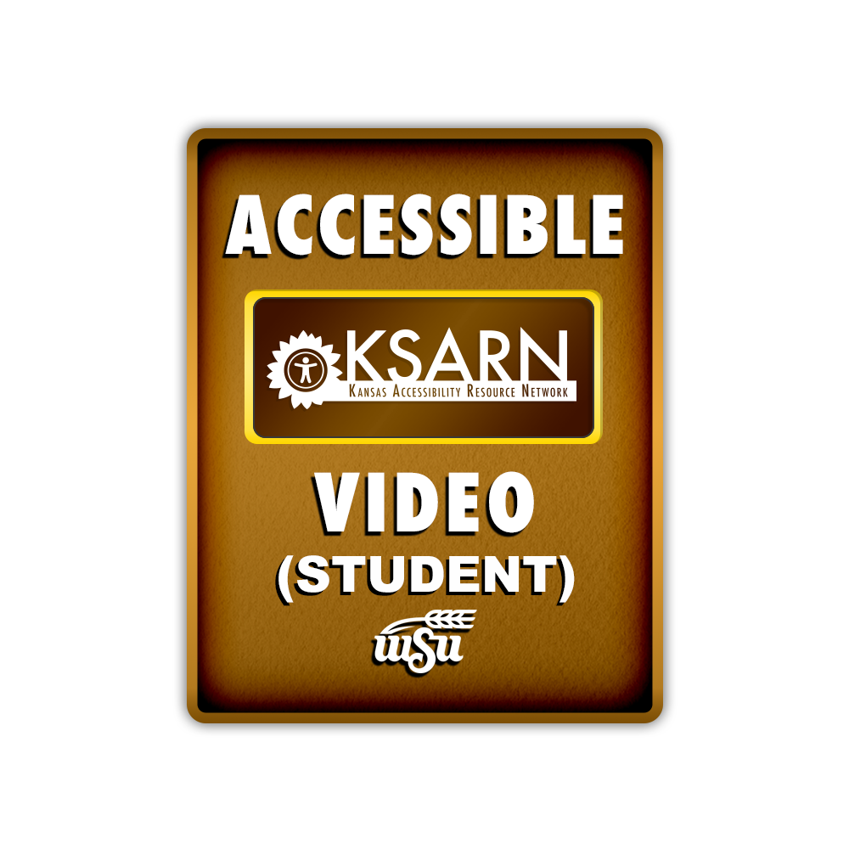
KSARN
Notes:
At this time there are 10 training courses at KSARN. Instructors do not have to create materials or spend time in their class delivering off-content training. All courses can be taken by all learners, but we group the course listing by likely target audience. This slide lists most of our currently available courses, and we suggest that students would be interested in Impairment Awareness, Accessible face-to-face presentation, creating accessible digital documents, creating accessible video for students, and accessible conference presentations. In addition to these classes we also offer creating accessible video for instructors and staff, introduction to web accessibility, and assistive technology. We also now offer a staff-focused course in remediating legacy documents. The Credly badges learners can earn list the title of the course, the KSARN logo, and also the logo of the university partner that created the content.

Slide 26
The student courses and topics 1 of 3
Impairment Awareness
Compare and contrast accessibility and accommodations
Define Universal Design and understand its benefits
Analyze documents for accessibility
List ways to improve accessibility
Accessible Face-to-Face Presentation
Accessible speaking
Accessible interacting
Accessible media use

Slide 27
The student courses and topics 2 of 3
Creating Accessible Digital Documents
AT for documents
Using Word’s tools
Accessibility checkers
Saving a document
Making accessible choices (color, images, tables)

Slide 28
The student courses and topics 3 of 3
Accessible Conference Presentations
Representing your content
Representing the conference
Session type considerations
Disability etiquette
Accessible Video (For Students)
What is accessible video?
Captions
Audio description
PowerPoint

Slide 29
Question: What are we missing?
Email KSARN@Wichita.edu with suggested topic and requests
Notes:
Question: what are we missing? Please let KSARN know what training you would like to see by emailing suggestions to KSARN@Wichita.edu

Slide 30
Why are we doing this?
Wichita State’s situation led to early development of accessibility trainings.
Consolidating them online allows us to deliver trackable training.
Opening it up to the community for free is WSU’s gift to the community.
Notes:
So, why are we doing this? After all, I paid to travel to the AHEAD conference and have handouts created, and we have no intention of making money with this project. How am I not secretly a vendor? The short answer is that we created and are promoting KSARN as a service to the higher education community. Wichita State’s situation with regard to the agreement with the National Federation of the Blind led to an early development of accessibility trainings. We needed a way to deliver these trainings to our instructors, staff, and students in an efficient and trackable way and to solve our challenges we decided to put our trainings on the Web. Once they were there, it was clear that other Kansas institutions would benefit from them, and KSARN was born as a result of WSU’s efforts to be a good citizen and leader in our state. Now that we are underway, the efficiencies that we created can easily be scaled to serve everyone needing accessibility training. This project is a free gift from Wichita State to the higher education community.

Slide 31
KSARN partners
We are now joined by partners:
Kansas State University
Johnson County Community College
Butler Community College
Cowley County Community College
… And you?
Notes:
And KSARN has been so successful that we have been able to attract partners. Wichita State is now joined by Kansas State University, Johnson County Community College, Butler Community College, and Cowley County Community College. Partners have authorship access to KSARN’s WordPress site and can create courses, post training articles, and index resources. We hope other institutions outside the state of Kansas will join us as partners in KSARN too.

Slide 32
Work together
Accessibility is everyone’s job. Let’s work together.
Notes:
After all, accessibility is everyone’s job. To be successful at all its complex and varied challenges, we will have to work together, be willing to take some risks, and look for inexpensive, scalable solutions.

Slide 33
Questions? And also…
Please see session moderator for paper evaluation form or complete the evaluation online.
Also: email comments to KSARN@Wichita.edu
Notes:
At this point, it was time for questions and evaluation. Please refer to KSARN’s FAQ at KSARN.org/faq/ for answers to some questions we hear a lot. If you would like to let us know if this presentation was worthwhile to you, please tell us by emailing KSARN and KSARN@Wichita.edu

